Slide 1
CITI Training
Guide

Slide 2
CITI Training
https://about.citiprogram.org/en/homepage/

Slide 3

Click on Register

Slide 4
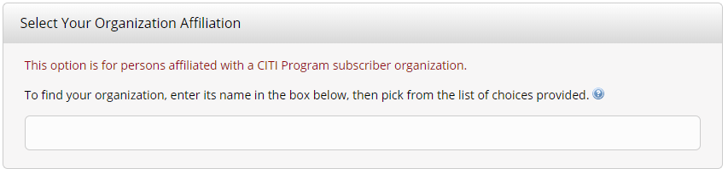
Enter Regis College

Slide 5
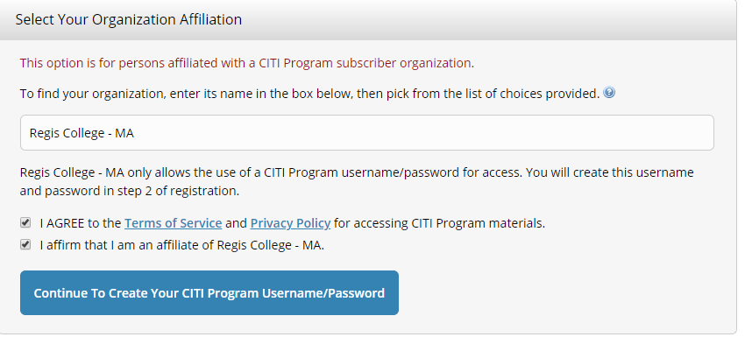
Check I agree and affirm, then click continue

Slide 6
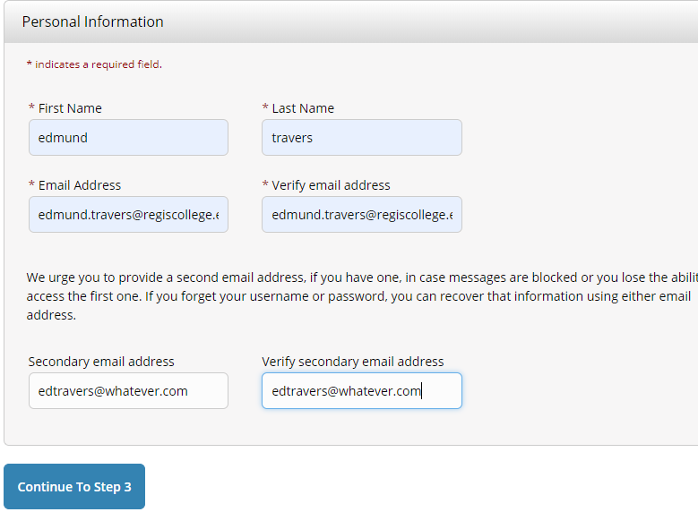
Complete and click continue

Slide 7
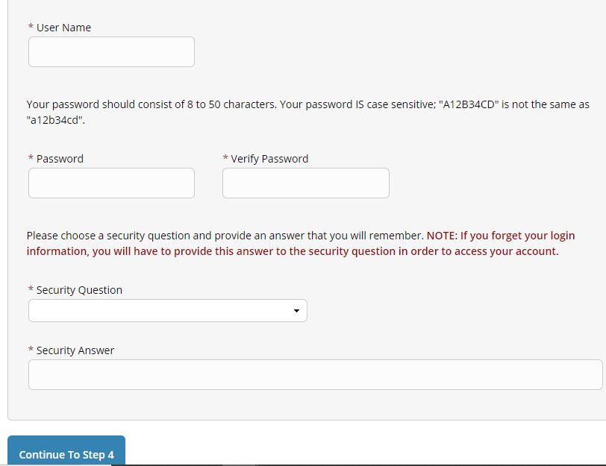
Click continue

Slide 8
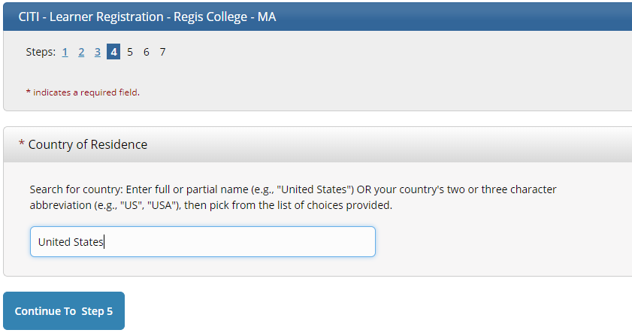
Click continue

Slide 9
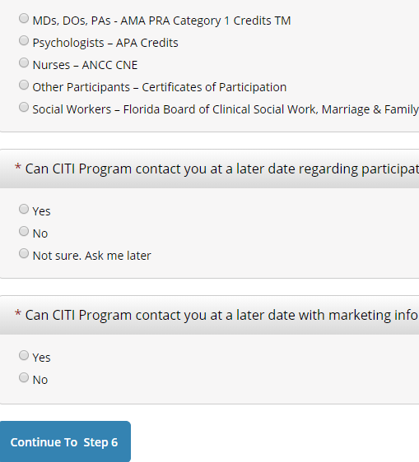
Answer all the questions if you want CEU’s

Slide 10
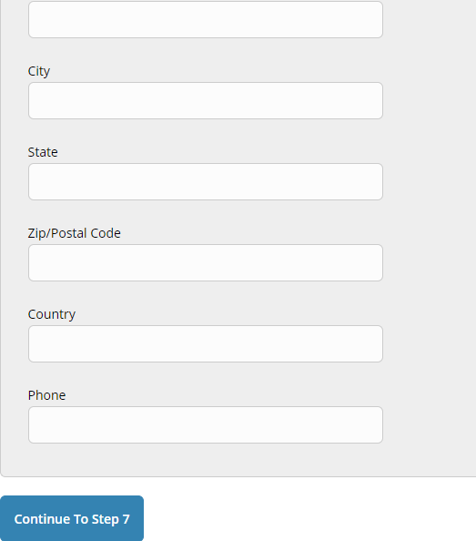
Complete entire page and click continue To complete the application

Slide 11
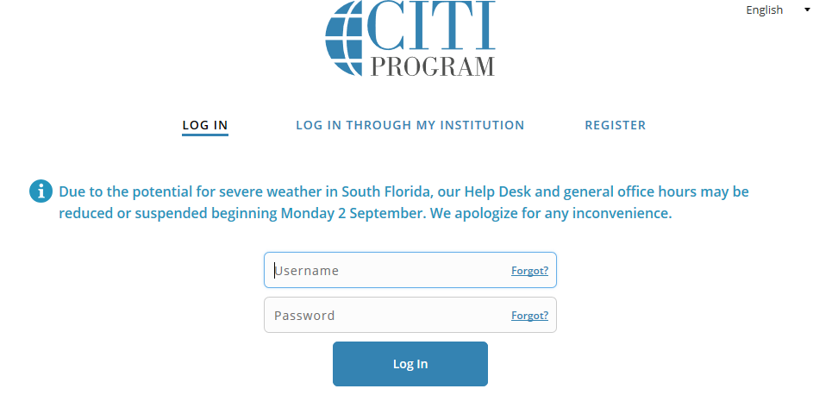
Then Log in

Slide 12
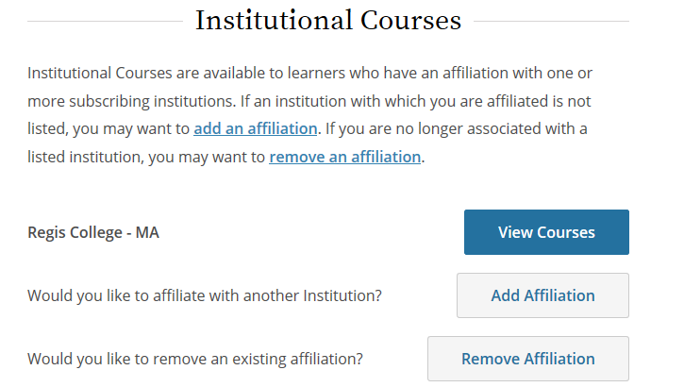
Click on View Courses

Slide 13
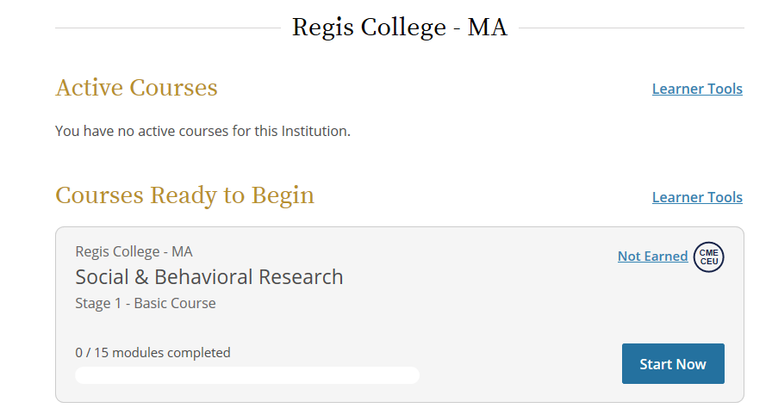
Click start now and finish all 15 modules

