Slide 1
Boston Medical Center Nursing
Responding to the workforce challenges
Nancy Gaden, DNP, RN Chief Nursing Officer

Slide 2

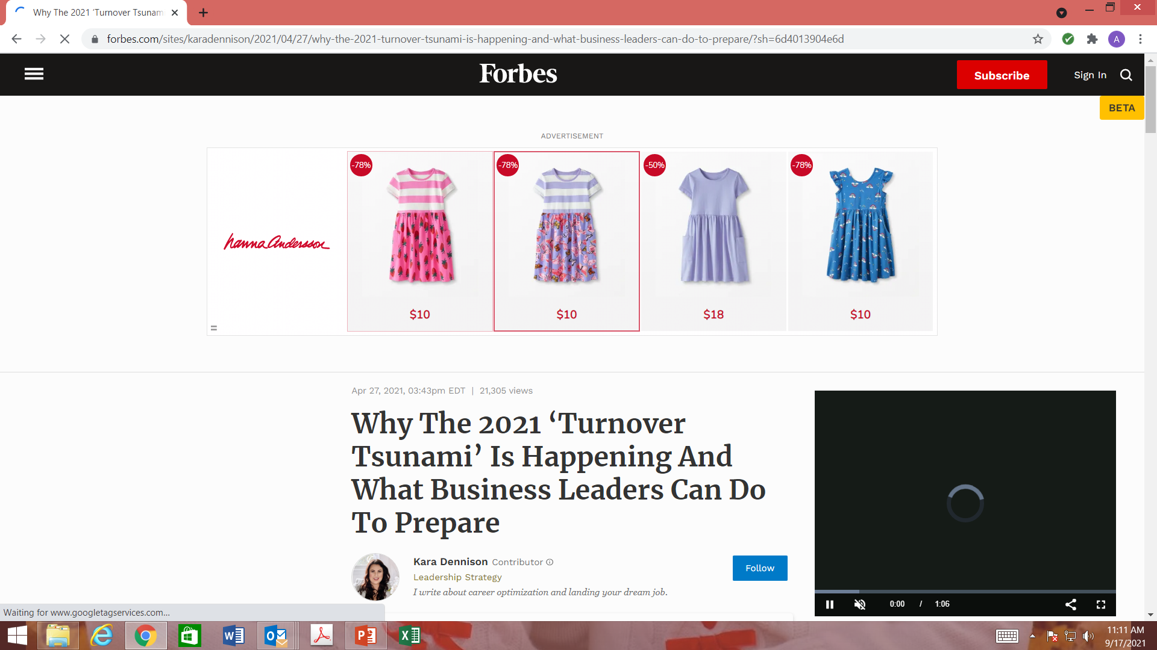

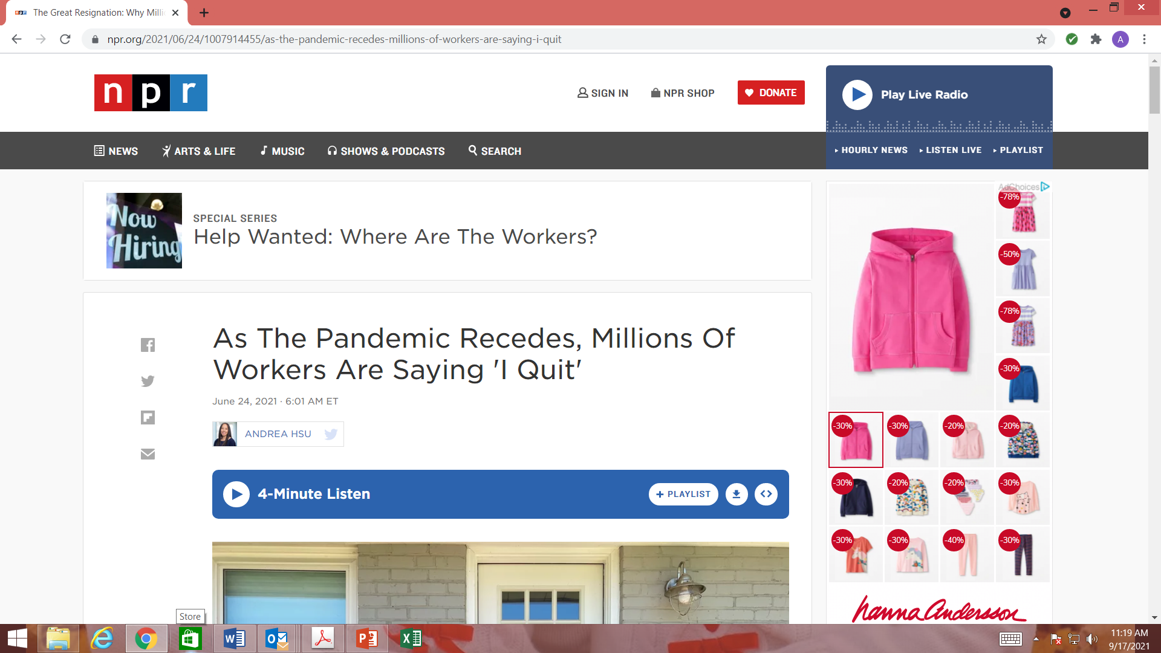

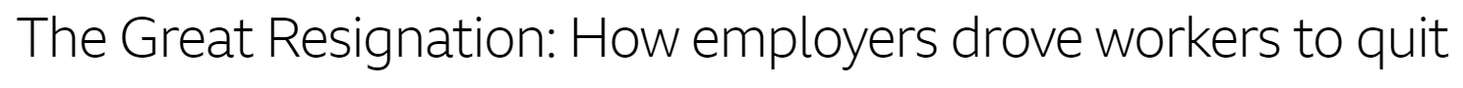
Recruitment and Retention are a national story
“
”
The Great Resignation
Turnover ‘Tsunami’ Expected Once Pandemic Ends
Studies show as many as half of workers intend to look for a new job this year
The “Turnover Tsunami”: Why Top Performers are Leaving Their Jobs

Slide 3
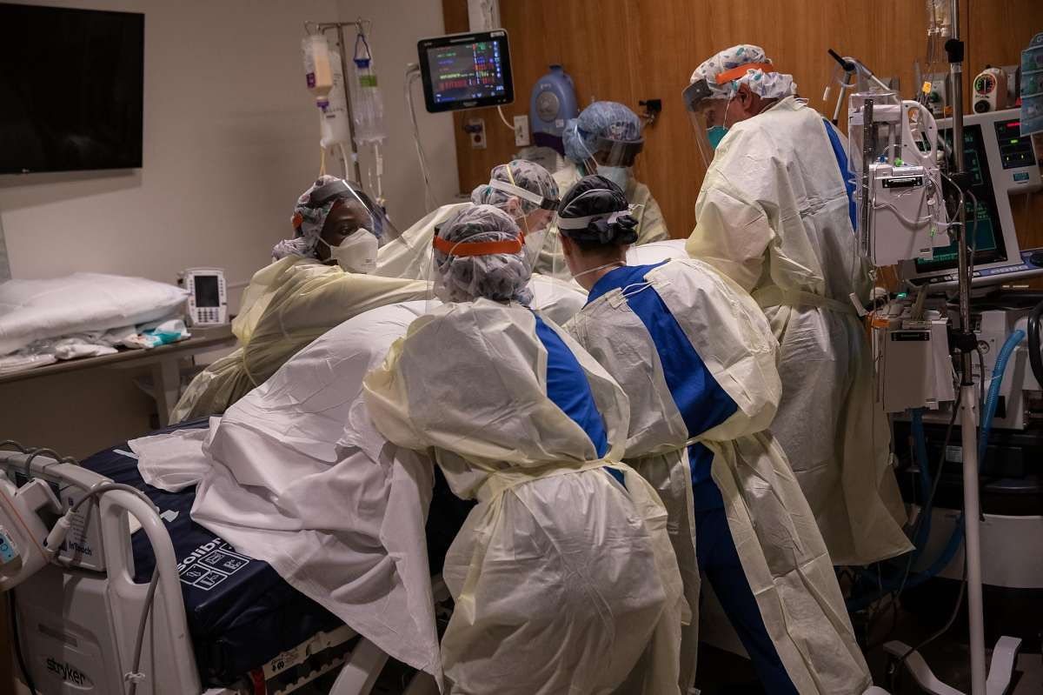
Nursing on the Frontlines “this shortage is different…”
From ONL - 2021

Slide 4
We are facing unprecedented RN shortages across the country
More than 15 million US workers – and counting - have quit their jobs since April 2021.
Within healthcare, Nursing has been particularly impacted with CNOs reporting higher turnover and higher vacancy rates than any time in recent history.
Nurses have faced a grueling 3 years due to the prolonged Covid-19 pandemic and ensuing workforce shortages. Nurses are decreasing their hours, retiring earlier than planned, taking leaves of absence, leaving their roles for less stressful positions, or resigning to take flexible and lucrative travel nurse assignments.
Travel nurses have historically provided a safety net, but are currently being used across the country as replacement staff for open positions. This has caused a market shift which increased travel rates significantly (pulling more early career nurses into travel nursing). There were 2200 travel nurses in MA in June 2020; in February, 2022, there were 11,774. Travel nurse numbers and salaries have decreased, but the flexibility is still a big draw.
Millennials and Gen Z nurses compromise about 1/3 of today’s nursing workforce and are evaluating work-life harmony, new professional experiences, better compensation, personal and family roles and wellbeing.

Slide 5
The “Great Resignation” at BMC led to increasing RN attrition, with especially high spikes among 1-2 year nurses impacted by COVID, and 2-5 year nurses leaving to travel
Average Monthly Turnover
# of terms (transfers out, change to per diem, terms)
FY20
May20-May21
May-Sept21
Critical Care
Med/Surg
Emergency Department
Maternal Child Health
OR+PACUs
Average Monthly Turnover Rate by Tenure
# of staff terms (excludes transfers out)
Notes: ¹ Examples include a group of six ICU nurses leaving together on traveler contracts to work at a hospital in New Mexico; anecdotal reports are of take-home pay of $125/hour for travelers

Slide 6
Workforce stability requires significant changes in how we approach nursing in terms of flexibility, professional opportunities, and wellbeing.
Amend hiring philosophy to cover short term needs
LOAs, vacations and coverage
Patient Care support
Onboarding
Core: Historic staffing plans
Professional Growth & Development
Recruitment
Leadership
Development
and support
Wellness

Slide 7
2023 turnover has returned to pre-Covid levels
% Turnover - Excluding Per Diems
 | July'22 | Aug'22 | Sep'22 | Oct'22 | Nov'22 | Dec'22 | Jan'23 | Feb'23 | Mar'23 | Apr'23 | May'23 | June'23 | July'23
00 - 01 Years | 1.5% | 1.5% | 4.4% | 2.8% | 3.8% | 2.4% | 2.5% | 3.0% | 1.7% | 1.7% | 2.1% | 1.3% | 1.3%
01 - 02 Years | 2.8% | 0.00% | 6.6% | 0.9% | 0.9% | 0.9% | 2.5% | 1.3% | 1.3% | 5.0% | 3.1% | 1.3% | 1.9%
02 - 05 Years | 0.6% | 0.9% | 0.3% | 1.2% | 1.8% | 0.9% | 1.3% | 1.3% | 0.3% | 0.6% | 0.6% | 0.3% | 0.6%
05 - 10 Years | 1.2% | 0.4% | 0.8% | 1.2% | 0.4% | 0.4% | 0.4% | 0.4% | 0.4% | 0.4% | 0.4% | 1.5% | 0.4%
10 - 15 Years | 0.0% | 0.00% | 0.00% | 1.8% | 0.0% | 1.8% | 0.0% | 0.0% | 0.0% | 0.0% | 1.8% | 1.8% | 0.0%
15 - 20 Years | 0.0% | 0.00% | 0.00% | 0.0% | 0.6% | 0.0% | 0.0% | 0.7% | 0.0% | 0.0% | 0.0% | 0.0% | 0.0%
20 - 24 Years | 0.6% | 0.00% | 0.6% | 0.0% | 1.2% | 0.0% | 1.1% | 0.0% | 0.6% | 0.6% | 0.0% | 1.1% | 0.0%
Lifetime Service | 0.0% | 0.00% | 1.5% | 1.5% | 0.8% | 0.8% | 0.8% | 0.8% | 0.0% | 0.8% | 0.0% | 0.4% | 1.1%
Total Terminations |  |  |  |  |  |  | 19 | 17 | 9 | 18 | 14 | 14 | 12
FY 2023 Key Takeaways:
  Regular RN turnover is annualized at 11.3% - back to pre-covid rates
  Turnover remains highest in the 0 to 5 year tenure categories: 72% of our turnover is in this category
  Our projected trend was that 26% of 0-1 year tenure terms in 2023 were probationary – and now we have improved that significantly
  The majority of 5+ year terms are related to retirement, or not returning from LOA
Notes:
Rehire data tracking

Slide 8
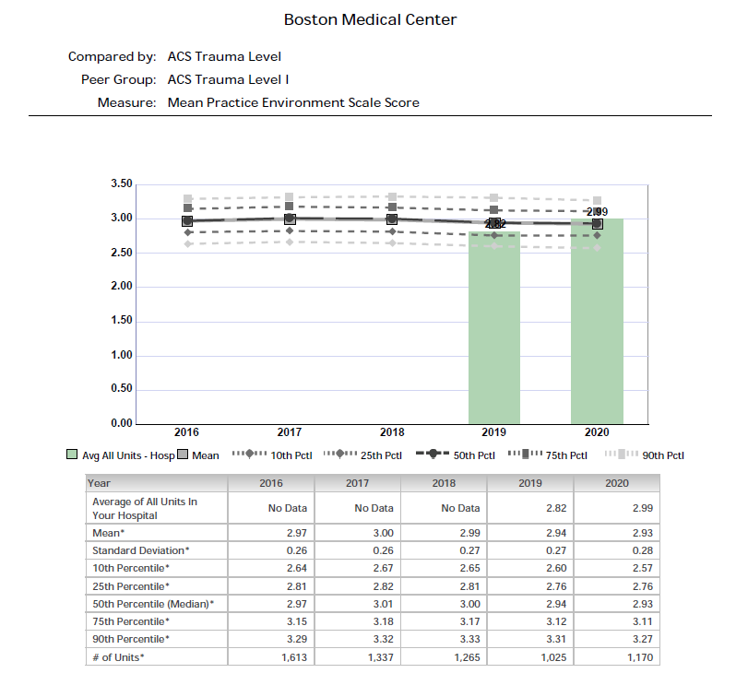
To address nursing retention, we believe in our Magnet culture - but this is an unprecedented time…
August 2020 NDNQI RN
Practice Environment
Survey Results
Every question improved
Every domain improved
Overall our score went from BELOW the mean to ABOVE the mean

Slide 9
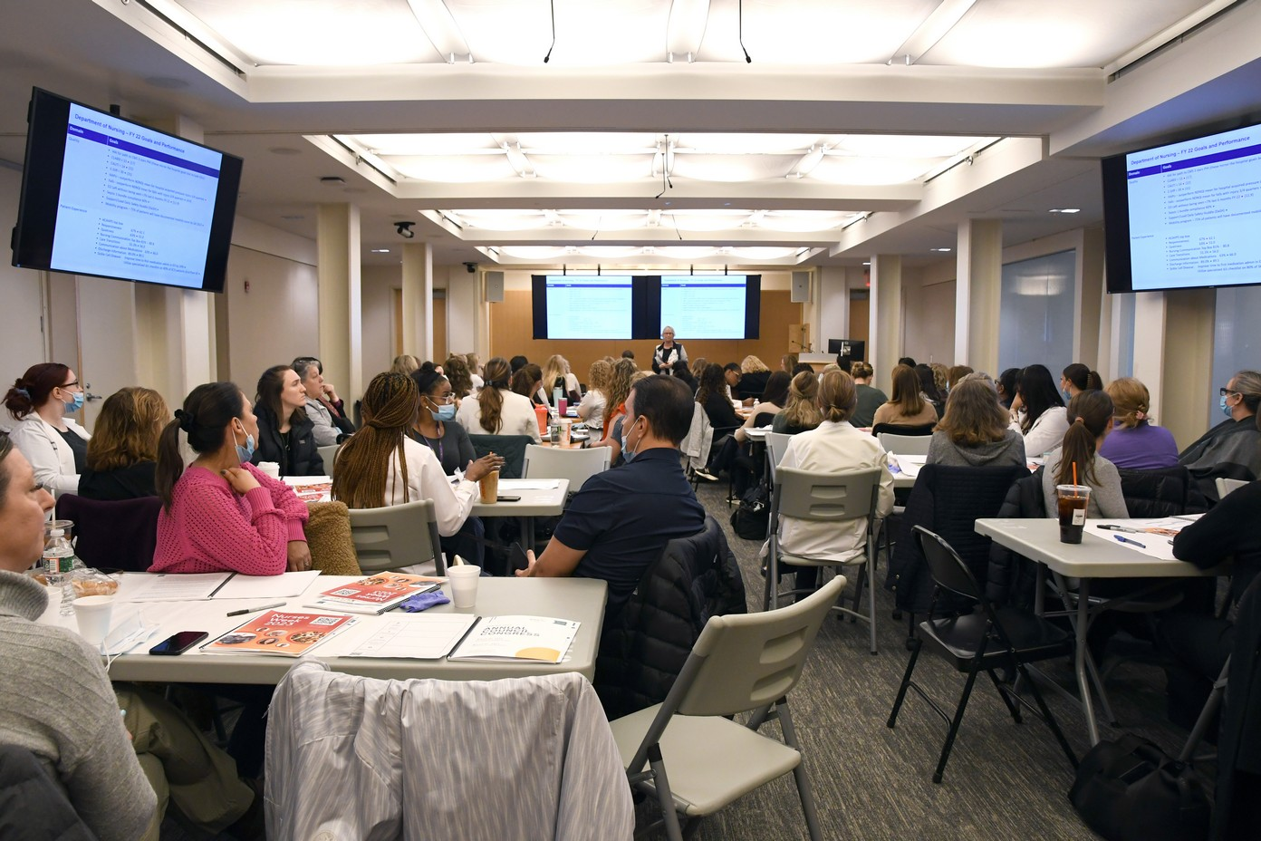
We believe strongly in Nursing Councils and nursing voice
BMC nursing leadership endorses shared governance. Shared governance is a collaboration among all nurses, whether scheduling staff, educating new staff, or implementing evidence-based practice. It involves teamwork, problem-solving, and accountability, with the goals of improved staff satisfaction, productivity, and patient outcomes.
It is working together to make decisions that affect nursing practice and patient care. We are committed to inter-professional collaboration focused on the primacy of patients. Institutions that utilize shared governance at the organizational, departmental, and unit levels experience decreased turnover rates and increased nursing satisfaction.
Nurse Practice Council
Nursing Informatics Council
Integrative Nursing Council
Nursing Substance Use Disorder Council
NICHE (Nursing Improving Care for
Healthsystem Elders) & Mobility Council
Night Council
Diversity, Equity, and Inclusion Council
Retention and Recruitment Council
Unit Based Councils

Slide 10
We continue to take multiple steps to strengthen our employee value proposition and address our market position
Tuition Repayment
RN Pay Adjustment
SEIU Contract changes
Implemented a program whereby nurses receive a pre-tax benefit for tuition repayment for their first degree (BSN or ASN)
Completed a thorough evaluation of the labor market for RNs & implemented market adjustments effective November, 2021 – and settled SEIU contract July, 2023
Increased the number of Weekend Incentive Nurse (WIN) positions, pilot month off program, stratified per diem language
RN Residency Programs
Novice nurse turnover actions
Retention/Recruitment Council
Implemented a variety of specialty RN residency programs (ED, Critical Care, Maternal Child Health,
Surgical Services)
Made significant investment in Nursing Education “generalist positions” in critical care, maternity, ED, and med surg, started 24/7 behavioral response team
Launched new hospital wide nursing council to develop retention strategies and assist with recruitment initiatives
RN fellowship programs
Nursing Recruiting
Targeted Advertising
Added Nursing fellowships in integrative care and informatics (in addition to SUD) Integrative nurses also “treat” staff
Updating and refining current landing page, increased partnerships with schools, improved talent acquisition team staffing and support
Continue to develop a diverse portfolio of advertising channels to directly target RNs
within & outside MA

Slide 11
The Recruitment and Retention Council
David Nguyen, BSN, RN

Slide 12
The BMC
Retention & Recruitment Council

Slide 13


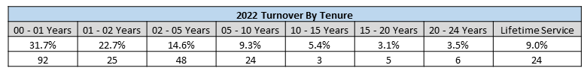
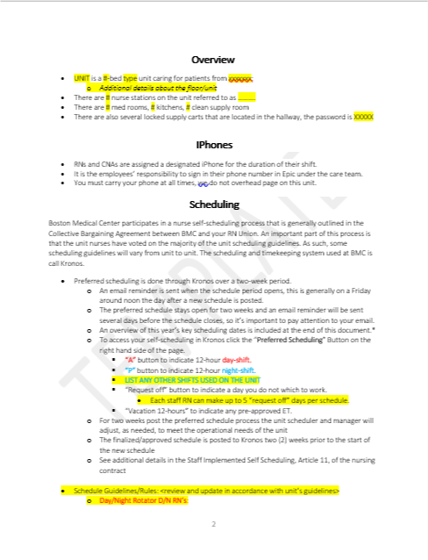
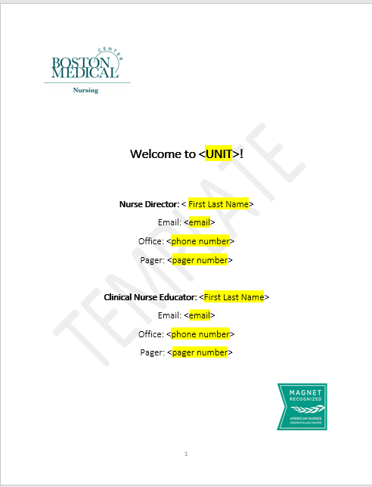
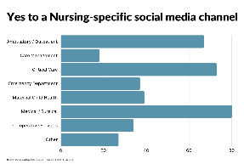
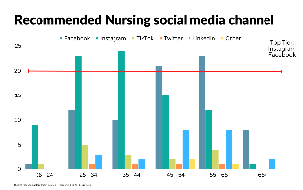
Retention and Recruitment Council
Boston Medical Center, Boston, Massachusetts 02118
Background / Problem
Methodology – What We Did
The ongoing pandemic has created a paradigm shift
in workforce and labor market dynamics across all industries. Individuals are responding differently to circumstances and are compelled to reassess their priorities and goals. Consequently, there has been observable changes in the nursing landscape.
Many nurses are opting for travel nursing, reducing work hours, shifting to telehealth opportunities,
leading to a significant turnover rate in healthcare organizations.
These factors have contributed to a noticeable surge in turnover rates at BMC, reaching 74% for nurses zero to five years of employment. To address this issue, a council was formed to develop strategies for improving retention and involving nurses more in the recruitment process.
The Council conducted a World Café brainstorm and identified five initial key themes:
  Welcome / Onboarding
  Social Media Presence
  Preceptor Program
  Certification / CEU
  Engagement/Activities
Members started with two themes and the following workgroups were established:
  Welcome/Onboarding – Leadership Sponsor: Kellie Smith
      Create a welcome packet template to serve as a centralized location for key unit operational information
      Unit information to be updated by each unit
  Social Media – Leadership Sponsor: Erlyn Ordinario
      Brainstorm ideas for content
      Conduct market research; discuss Nursing brand
      Develop a content strategy
      Create a staff survey
Additional planning work: Coffee Hours for New Hires, Nurses Week Activities, Recruitment Event Calendar, Exit Interviews,
Outcome, Results & Growth
Who We Are
Welcome Packet template
completed by Council
Present to Nursing Leadership
Follow-up email with “ask”
Templates updated
Templates returned
Orientation packet put into practice
Usage and updates
The Retention and Recruitment Council is a 27-member team comprising of 23 staff nurses, two nursing leadership personnel, and three members from Human Resources.
The council includes nurses from diverse areas such as the GI Clinic, 3W IMCU, 5W IMCU, Endovascular, 4W, 6W, 7E, MICU A, MICU B, PACU Nursing, SICU, Maternity, Family Medicine, OBGYN, Adult ED.
The members of the council are fully engaged and participate actively in every meeting, held on a monthly basis. They have a genuine interest in expanding representation by having new members join the council.
Social Media Update
Strong response from Ambulatory, Critical Care and Medical/Surgical areas
Instagram favored among
25-44 age group
Facebook favored among
45-65 age group
Move to obtain a “public-facing” Instagram account
Nursing private FB group to remain internal for now
Soft launch anticipated for Nurses Week in May – to start with Nurses Week content
Purpose and Goals
Provide a forum for inter-professional colleagues to discuss retention, engagement and recruitment best practice strategies to ensure an adequate and engaged inter-professional workforce.
Promote and disseminate best practices strategies for the retention, engagement and recruitment of the inter-professional workforce.

Slide 14
The retention & recruitment staff nurse council has begun implementing early actions and continues to reassess meaningful actions aimed at retention
In Implementation
Welcome gifts
New hire coffee hours
Unit profiles
Attending University recruitment events
Attending National conferences for recruitment
Planning Phase
Nursing Instagram channel
Peer exit interviews
Social gatherings
New graduate community
Future Focus
Ambassador/mentor program
Fostering Healthy Workplace (HOPE)
Social/Volunteerism -Organizational Embeddedness

Slide 15
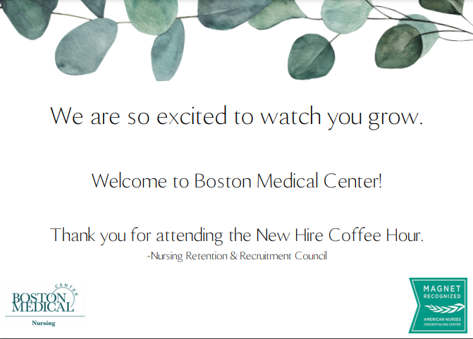
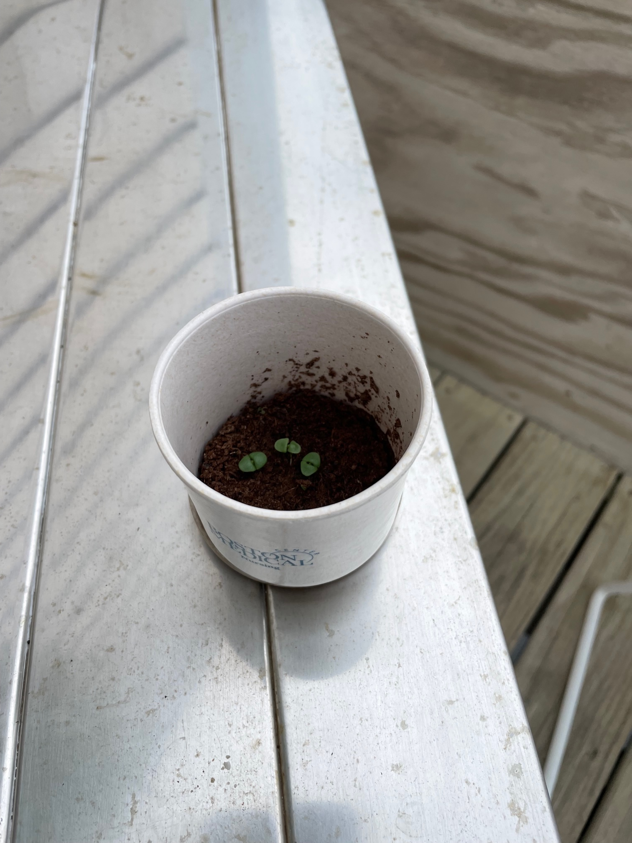
“Coffee Hours” for New Hires – Gift
Notes:
Is there a way to get someone interested in attending town hall meeting?
Watch town hall meeting in the coffee hour
Day/night shift sessions – organize around classes – could build into orientation schedule – middle of day

Slide 16
Orientation Packet
Welcome packet template to serve as a centralized lactation for key unit operational information that hasn’t always been written down
Information Included (not complete list):
  Unit overview
  IPhones
  Scheduling
  Sick call guidelines, Vacation request process, Self-Coverage, Holidays
  Floating
  Canceled shifts
  Locker policy
  How to get involved in Nursing committees
  Workday and Kronos information
  Educational Benefits
Unit information will need to be updated by each unit

Slide 17
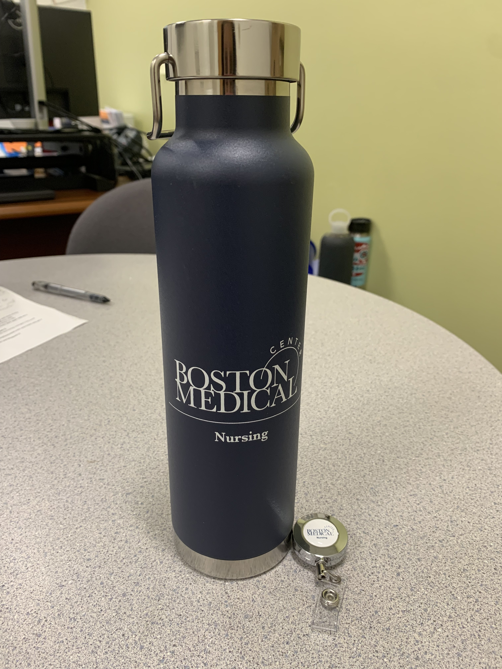
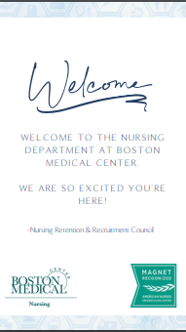
Welcome Gifts

Slide 18
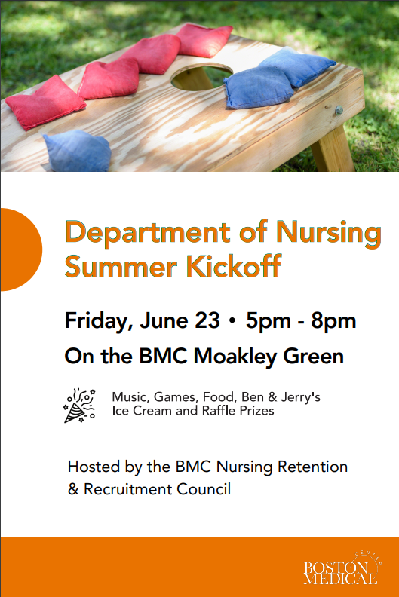
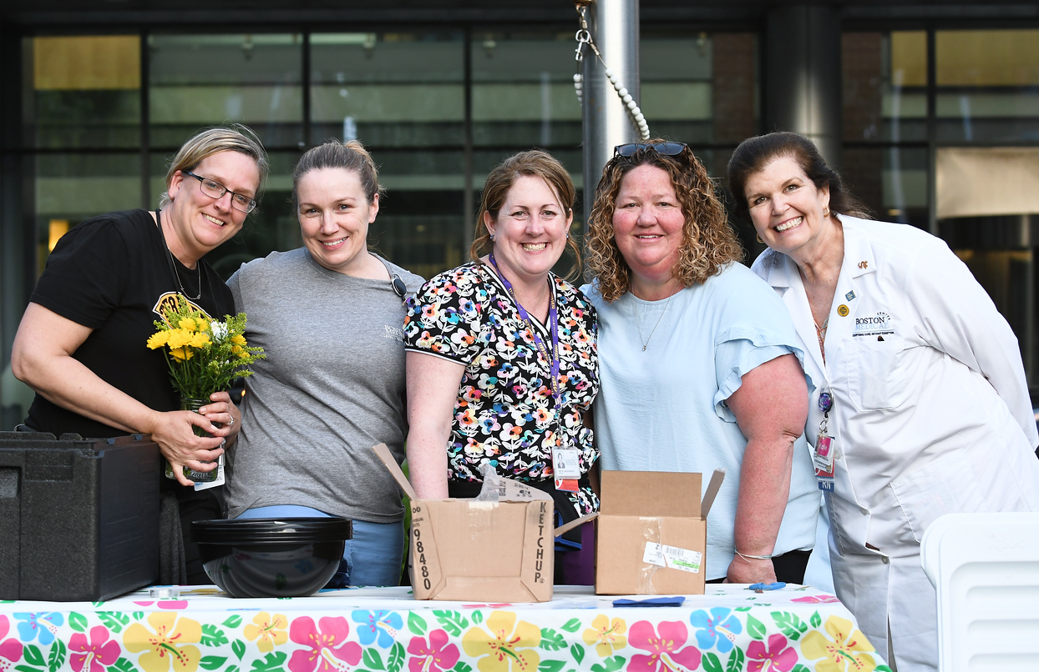
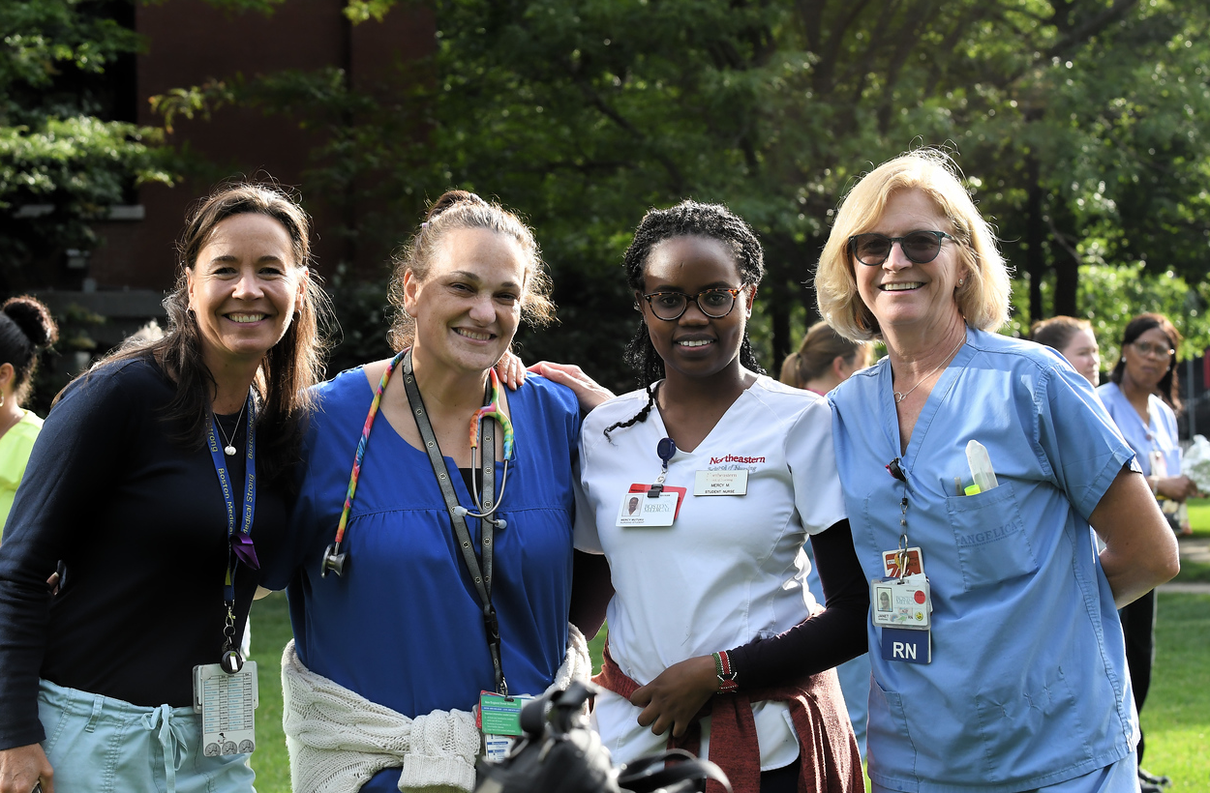
Summer Kickoff Event to Launch Social Events

Slide 19
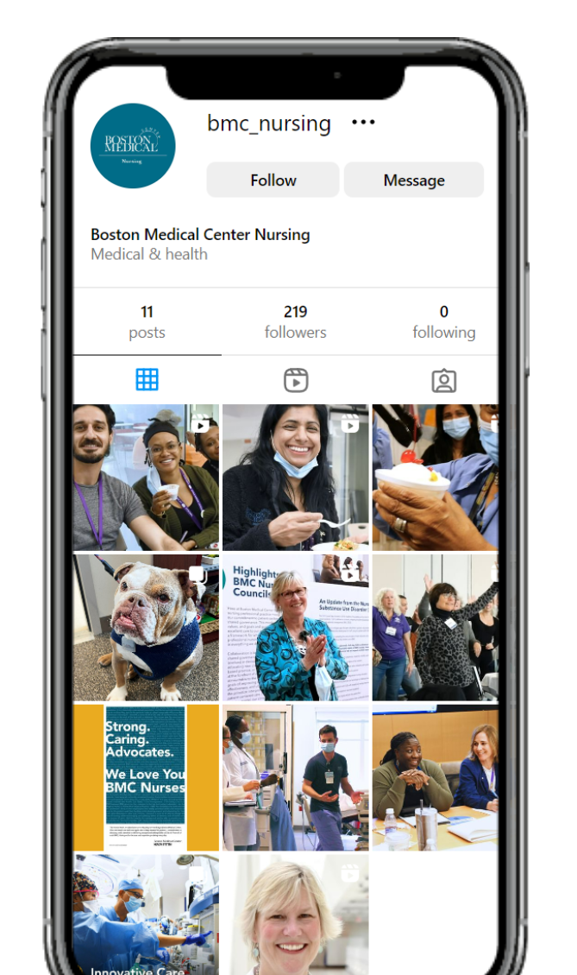
Nursing Instagram Channel
Members of the Nursing Retention and Recruitment Council identified the key themes to address turnover rates at BMC and develop strategies for improving retention and involving nurses more in the recruitment process. One of those themes was developing a social media presence.
The Nursing social media workgroup:
  Brainstormed ideas for content
  Conducted market research and discussed the Nursing brand
  Developed a content strategy
  Created a staff survey
Survey Results
  A strong response from Ambulatory, Critical Care, and Medical/Surgical areas
  Instagram favored among 25-44-year-olds
  Facebook favored among 45-65-year-olds
  Move to obtain an external Instagram account
  Nursing private FB group to remain internal for now
Nursing launched on Thursday, May 4th!

Slide 20
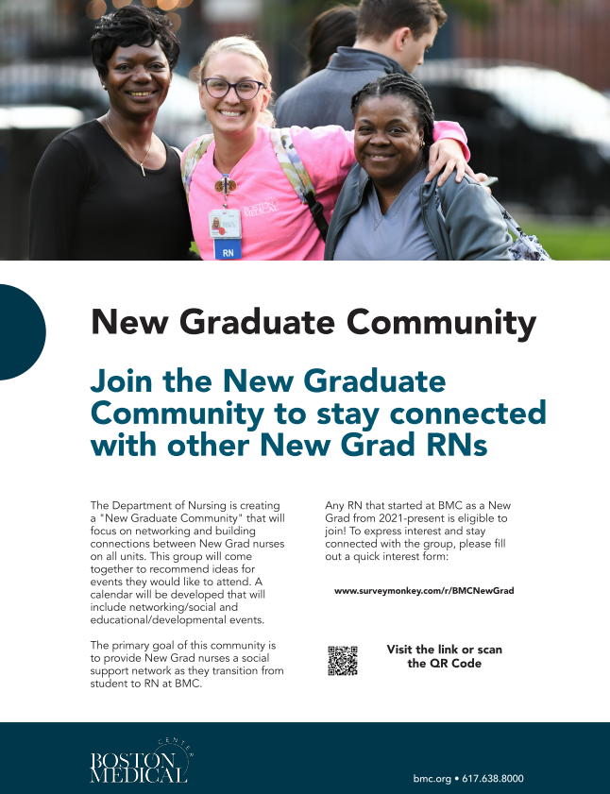
New Graduate Community
Purpose:
    To foster camaraderie and development after orientation and build a strong commitment to BMC
Overview:
    Allows New Grad RNs to come together and build a network of support as they transition from student to RN. Members will provide suggestions on events they would like to attend (both social and educational/developmental). First event will be an informal meet & greet.
Membership:
    Any New Grad RN that started at BMC from 2021-present (2 year membership term)
    Fill out quick interest form via Survey Monkey to stay connected/become a member of the Community
Recruitment:
    Flyers with QR code/link to Survey Monkey interest form: night time educators hand out, posted around BMC
    Email from Nancy, Leaders, Nursing Top 5
    Add a slide to orientation, TA promotes during recruitment process
Notes:
2nd reason question

Slide 21
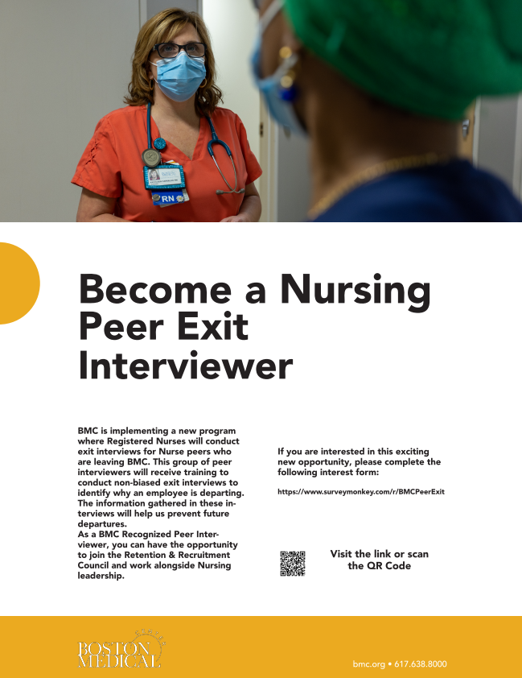
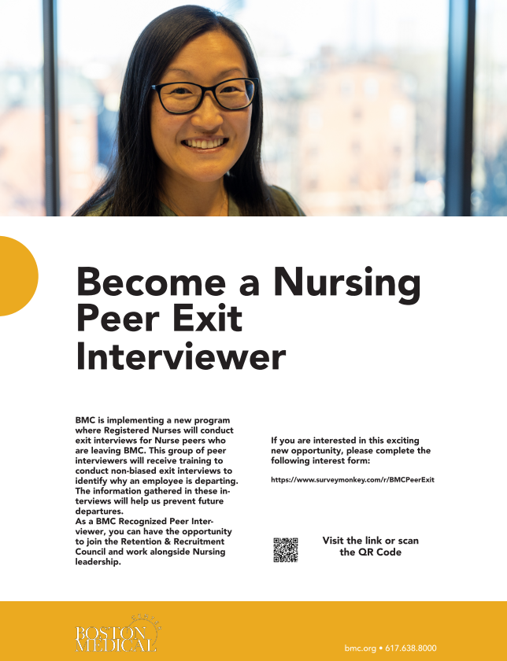
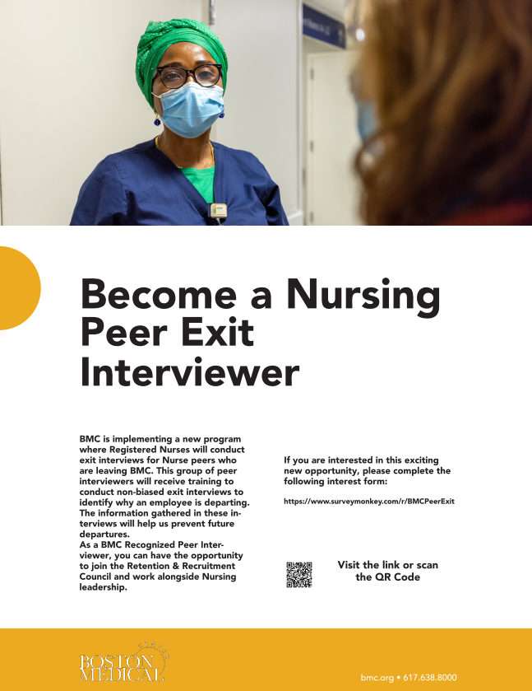
Peer Exit Interviewer Flyers
Notes:
Did any of these experiences contribute to your decision to leave?
What did you consider
What were your expectations when you started and how were the met and/or not met?

Slide 22
Questions….
For Nancy or David

